Slide 1

Allison Chin, Liam Kopp, Kaijie Zhang, Sadman Sakib

Slide 2
PRESENTATION SUMMARY
Introduction
Motivation
System overview
Results
Conclusions
Notes:
Introduction – explain what the device is
Motivation – why we think this is device is so important and unique
System overview – More detail on the components of each part of the device
Challenges and next steps -

Slide 3
INTRODUCTION
EEG Concussion Assessment Tool for Sport
Sport concussion diagnosis aid
Sensor to detect impacts
EEG to measure brain activity
Monitoring from sideline

Slide 4
SENSOR
Sensor to detect impacts
High impact sports (hockey, football)
Embedded in the helmet

Slide 5
EEG
EEG to measure brain activity
Headband inside helmet

Slide 6
MONITORING
Monitoring from sideline
Coach or trainer uses laptop or cellphone
Real-time updates on

Slide 7
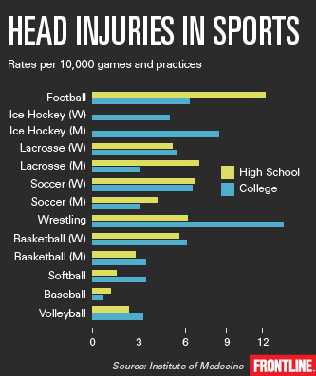
HOW BIG IS THIS PROBLEM?
Impact causing a mild traumatic brain injury
39% youth and children diagnosed with concussion in the ER
Cognitive tests
Memory, balance,
concentration, speed

Slide 8
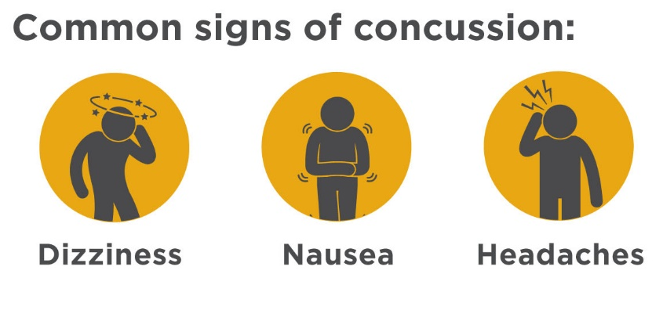

HOW BIG IS THIS PROBLEM?
Return-to-play guidelines
Must pass neuropsychological tests
Increase activity slowly before returning to play
Consecutive concussions
Increased chance of another concussive episode
Long term effects of multiple brain injuries

Slide 9
OUR SOLUTION
Unique device to help with diagnosis
Real-time
Current devices lack ability to analyze brain activity immediately
Help prevent second-impact syndrome

Slide 10
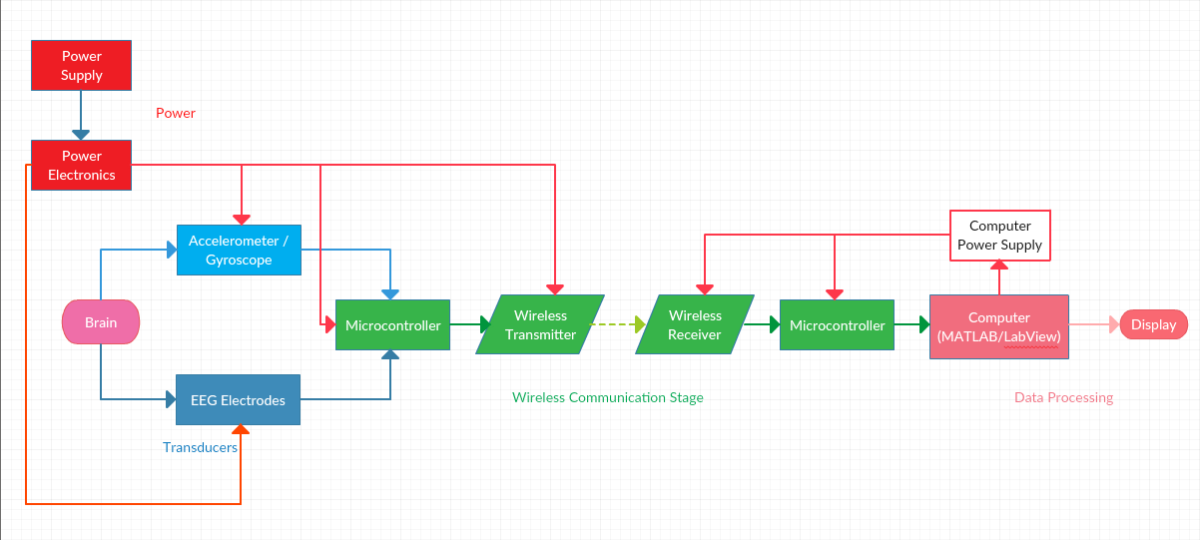
SYSTEM OVERVIEW
Notes:
This block diagram shows the current system overview and interactions between the different components.

Slide 11
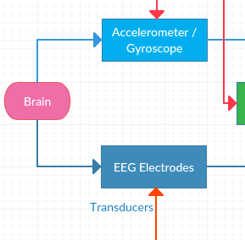
SYSTEM OVERVIEW
Transducers
Accelerometer/Gyroscope detects heavy impacts that are of concern
EEG electrodes monitors brain activity post-impact

Slide 12
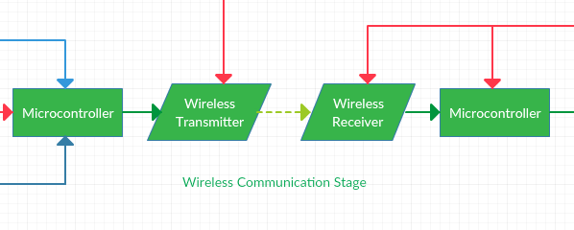
SYSTEM OVERVIEW
Wireless Communication
Two microcontrollers with wireless capability to act as transmitter and receiver
Dedicated WLAN to enable communication of several EEG helmets

Slide 13
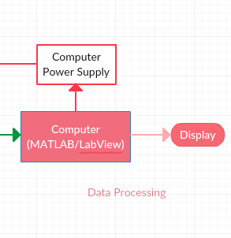
SYSTEM OVERVIEW
Data processing
Remote Computer will be used to monitor many players during a game
MATLAB/LabVIEW will primarily be used for data processing

Slide 14
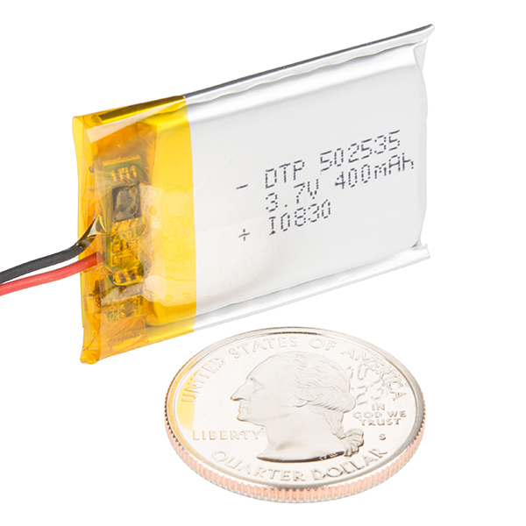
SYSTEM OVERVIEW
Power Supply
Lithium Ion batteries for components in helmet
Computer Power Supply Unit for components connected to the computer

Slide 15
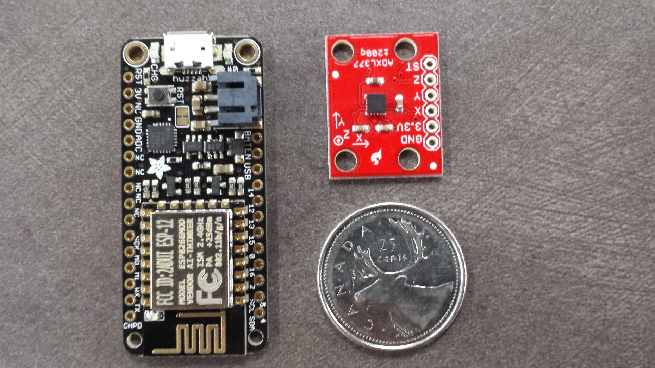
PROCURED COMPONENTS

Slide 16
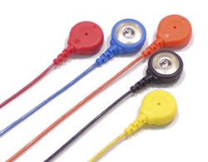
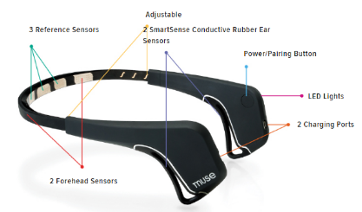
POSSIBLE CHALLENGES
Hard to maintain position of electrodes
Lack of stability may result in more motion artifacts
May using band, similar to Muse

Slide 17
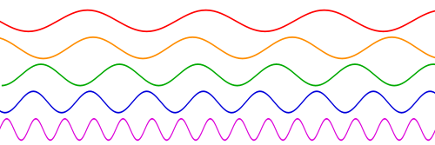
POSSIBLE CHALLENGES
May not detect concussions, only show potential problem
Signals will not have entirely different characteristics post-injury
Variability in the helmet for users

Slide 18
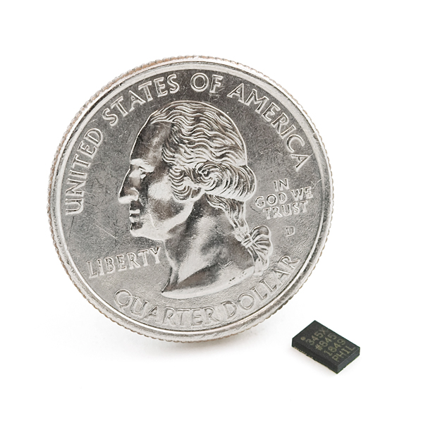
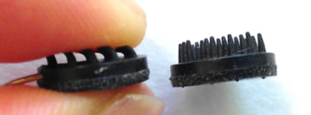
SETBACKS
Testing will be difficult; chances of concussion are low
Bought accelerometer that was too small and can’t solder
Difficulty local stores that sell suitable electrodes

Slide 19
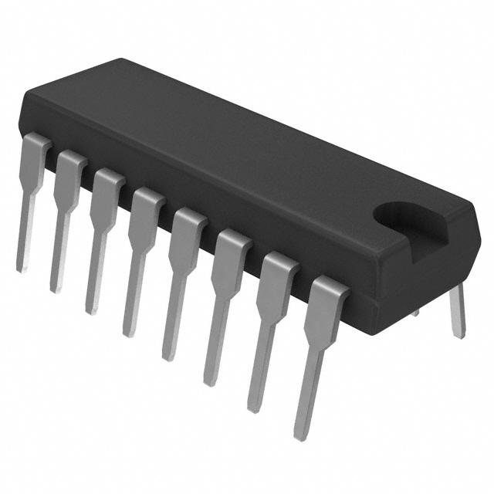
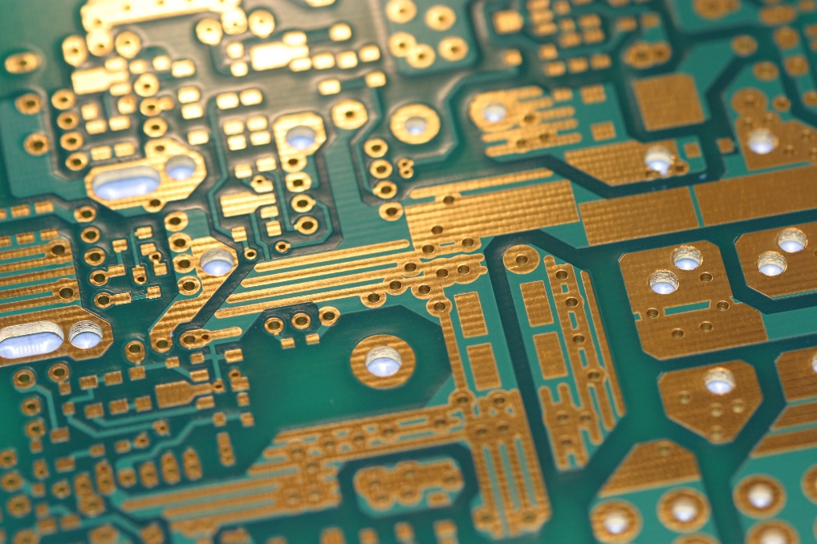
NEXT STEPS
Purchase ADC for signal processing
Communicate between two Wi-Fi microcontrollers
Design analog amplification & filter circuit

